Slide 1
ML Model for Auto Insurance Industry
Gaurav Mandloi

Slide 2
Output of deliverables
1. Write at least 3 important inferences from the data above
2. Is the data balanced? Meaning are targets 0 and 1 in right proportion?
3. How many categorical features are there?
4. How many binary features are there?
5. Write inferences from data on Interval variables.
6. Write inferences from data on ordinal variables.
7. Write inferences from data on binary variables.
8. Check if the target data is proportionate or not. Hint: Below than 30% for binary data is sign of imbalance

Slide 3
Continue….
9. What should be the preferred way in this case to balance the data?
10. How many training records are there after achieving balance of 12 %?
11. Which are the top two features in terms of missing values?
12. In total how many features have missing values?
13. What steps should be taken to handle the missing data?
14. Which interval variables have strong correlation?
15. What's the level of correlation among ordinal features?
16. Implement Hot Encoding for categorical features
17. In nominal and interval features which features are suitable for StandardScaler?
18. Summarize the learnings of ED

Slide 4
1. Write at least 3 important inferences from the data above
Ans.:
Data is higly imblaced, target distribtion is:
0 = 96.36 %
1 = 3.64 %
data have vaiable type:
Interval = 45.6
binary =29.8
categorical = 24.6
Most of the features are uncorrelated

Slide 5
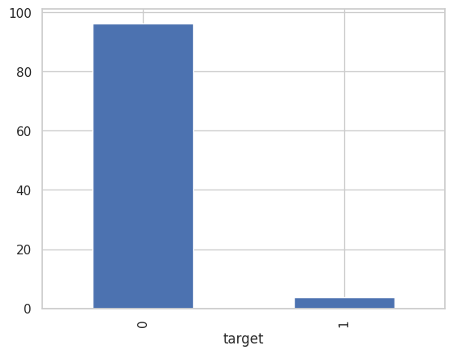
2. Is the data balanced? Meaning are targets 0 and 1 in right proportion?
Ans: No data is not balanced

Slide 6
3. How many categorical features are there?
Ans: Categorical Variables= 50
group_variable_type = metadata_matrix_dataframe.groupby('Variable_Type')
print("categorical features count:",group_variable_type.get_group('Categorical').shape[0])

Slide 7
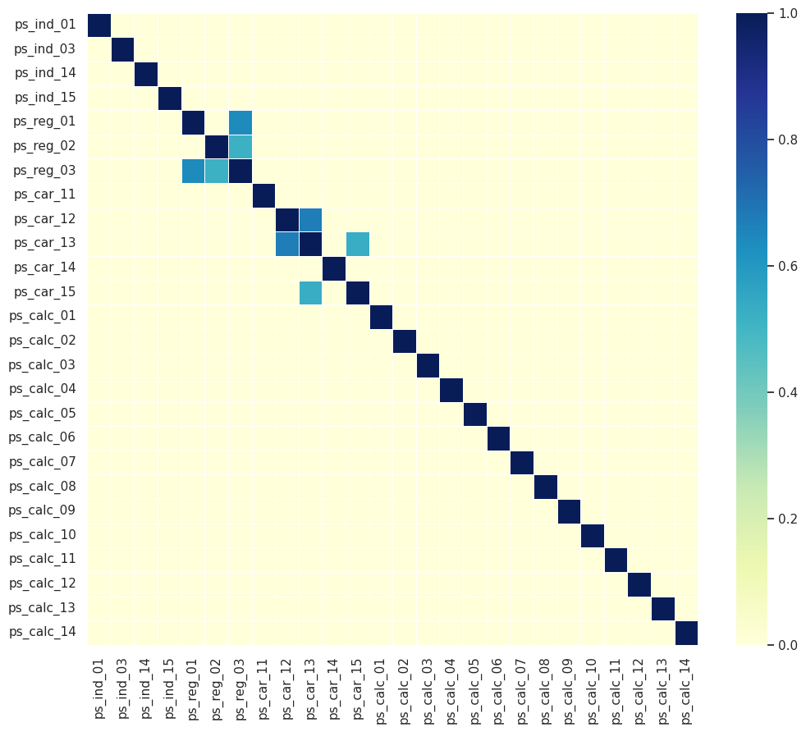
4. Write inferences from data on Interval variables.

Slide 8
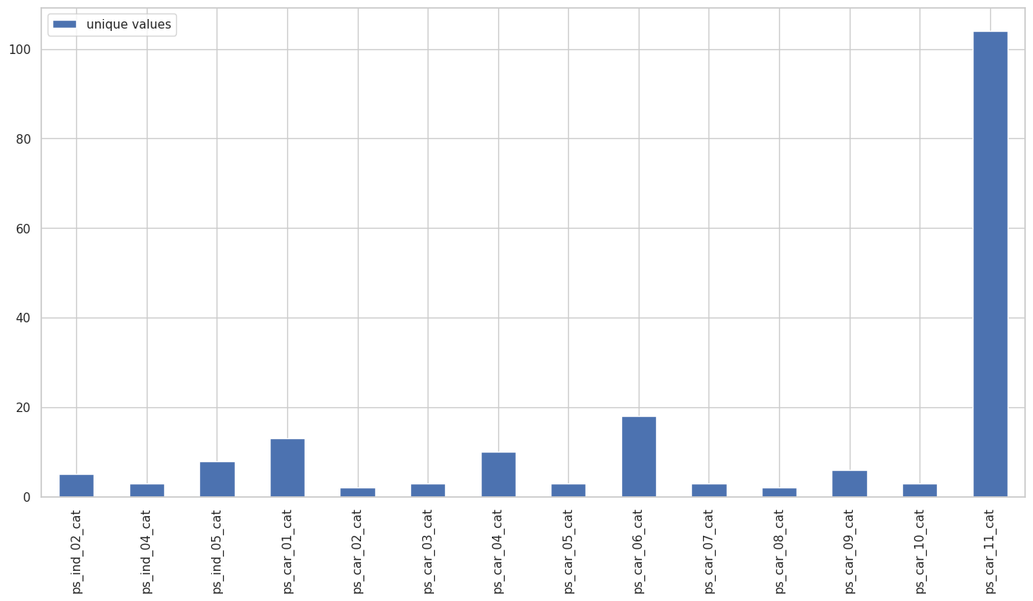
5. Write inferences from data on ordinal variables.

Slide 9
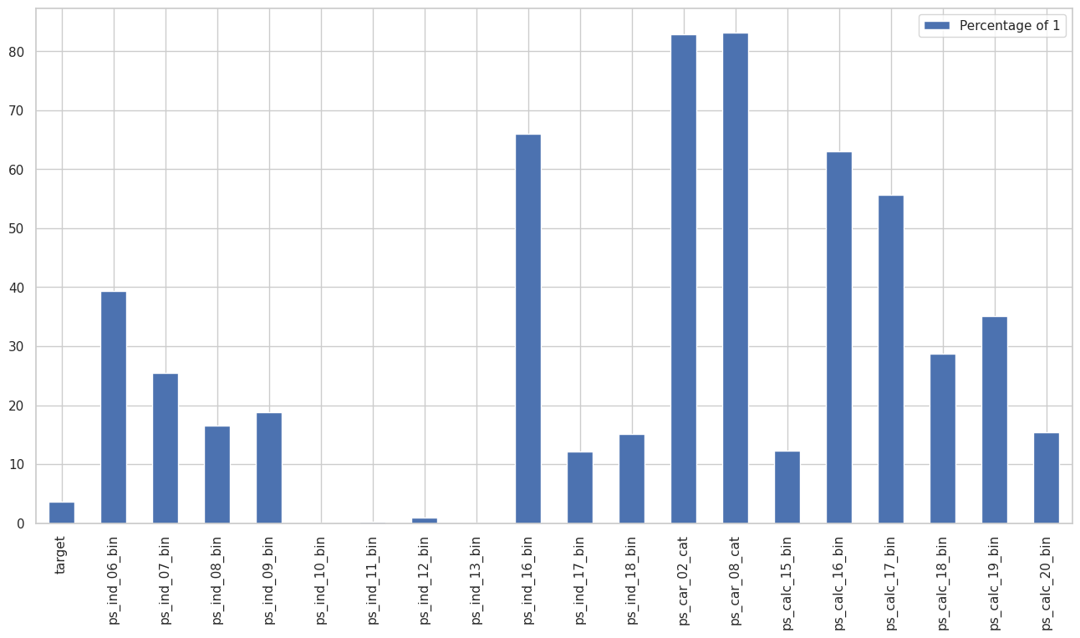
7. Write inferences from data on binary variables.

Slide 10
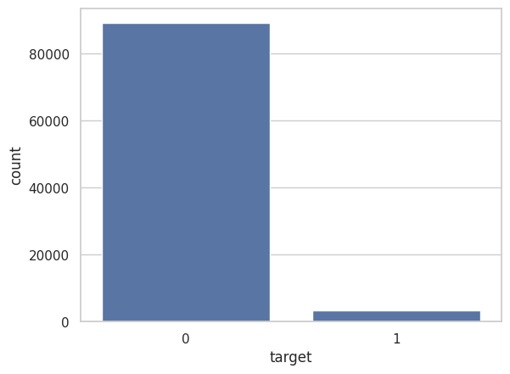
8. Check if the target data is proportionate or not. Hint: Below than 30% for binary data is sign of imbalance Ans: Target=1 shape: (3401, 59) 3.67 % Target=0 shape: (89174, 59) 96.33 %

Slide 11
9. What should be the preferred way in this case to balance the data?
The most popular solution to an imbalanced classification problem is to change the composition of the training dataset. Techniques designed to change the class distribution in the training dataset are generally referred to as sampling methods or resampling methods as we are sampling an existing data sample.

Slide 12
10. How many training records are there after achieving balance of 12 %?
# using resampling technique, splittinf data into classes
df_mino= df[df['target']==1]
df_majo= df[df['target']==0]
df_mino_upsampled = resample(df_mino,replace=True,n_samples=int(len(df_majo)*0.12), random_state = 42)
print("Size of data, after achieving a balance of 12%: ", df_mino_upsampled.shape[0] + df_majo.shape[0])
Ans: Size of data, after achieving a balance of 12%: 99874

Slide 13
11. Which are the top two features in terms of missing values? No Missing Value Found. 12. In total how many features have missing values? No Feature having missing values 13. What steps should be taken to handle the missing data? NA

Slide 14
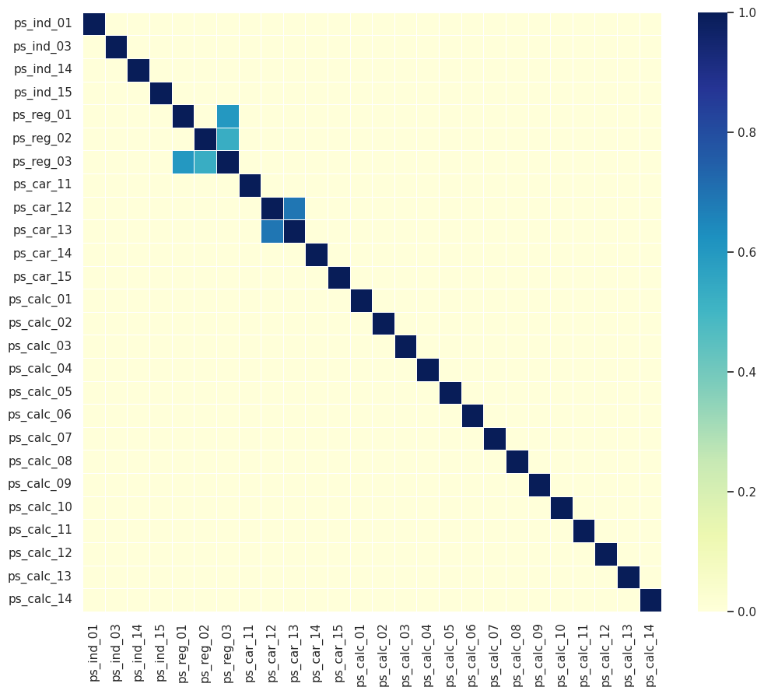
14. Which interval variables have strong correlation?

Slide 15
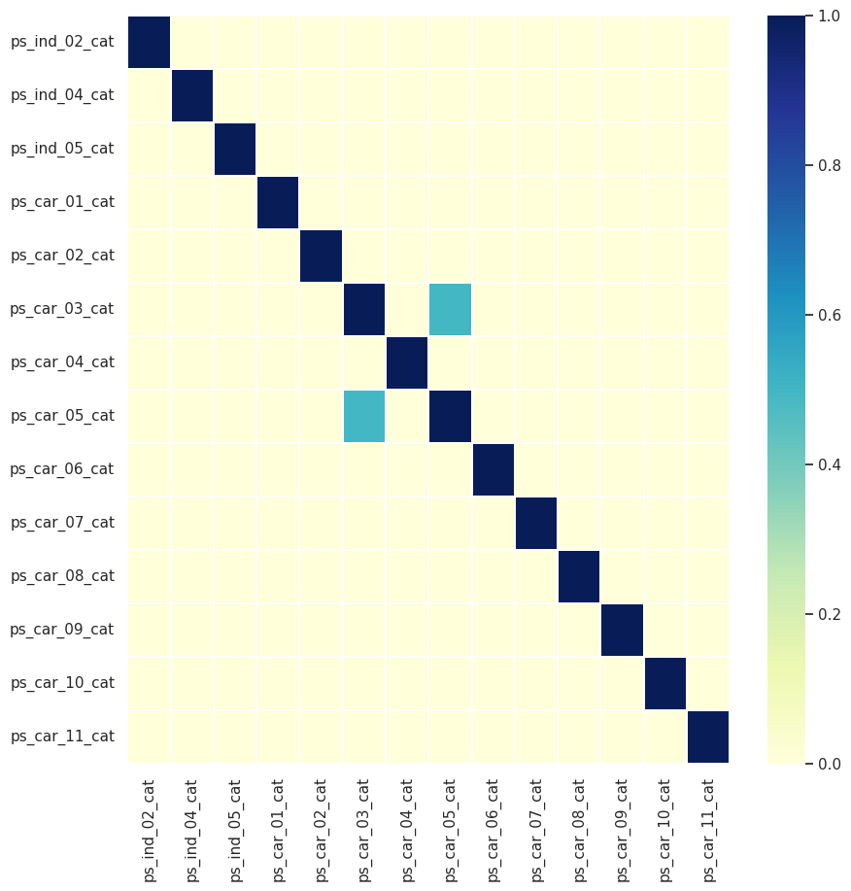
15. What's the level of correlation among ordinal features? temp = df[cat_feature].corr() temp = temp[(temp>=0.3) | (temp<=-0.3)].fillna(0) fig, ax = plt.subplots(figsize=(10,10)) sns.heatmap(temp,linewidths=.3, cmap="YlGnBu",ax=ax) plt.show()

Slide 16
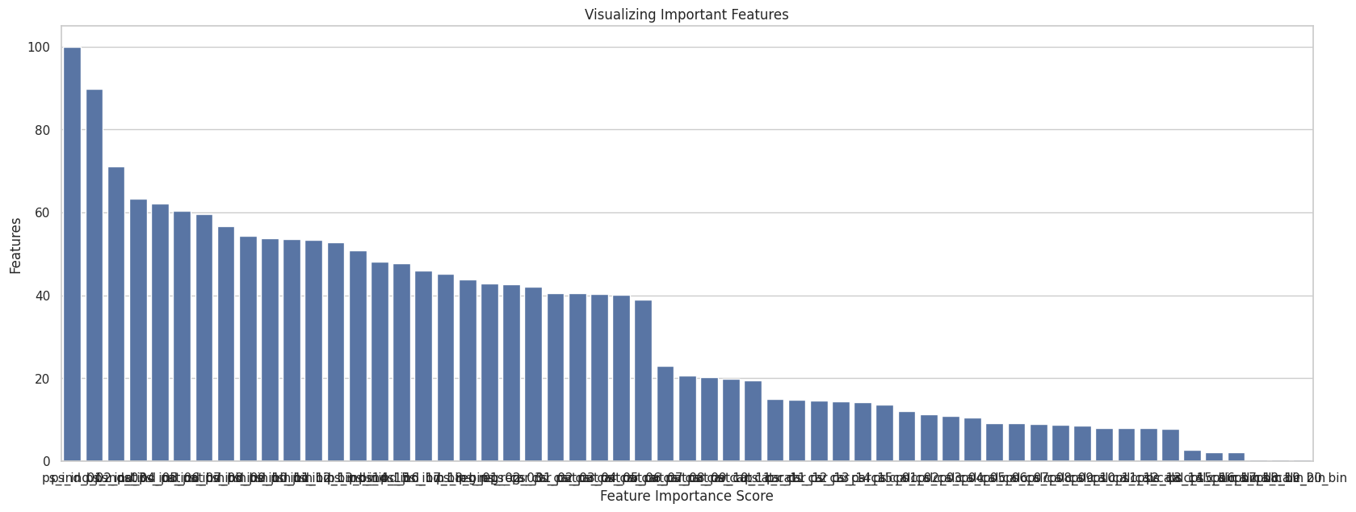
16. Implement Hot Encoding for categorical features
No, nominal Features are available
17. In nominal and interval features which features are suitable for StandardScaler?

Slide 17
18. Summarize the learnings of ED
Data is higly imblaced, target distribtion is:
0 = 96.36 %
1 = 3.64 %
2 Most of the features are uncorrelated
Top 10 ordered important features
ps_car_13
ps_reg_03
ps_car_14
ps_calc_10
ps_calc_14
ps_calc_11
ps_car_11_cat
ps_ind_15
ps_ind_03
ps_calc_01

Slide 18
Thank you
Gaurav Mandloi
gmandloi27@gnail.com

